Slide 1


Team 2
Data Analysis of the Spotify Data from 1960s to 2010s
By Gulzhan, Firuz, Kalys

Slide 2
Overview
Business Question
Data Cleaning
Exploratory Analysis
Feature Engineering
Modeling phase
Product change
Objective: helping a music producer look for ways to improve the chances their new song can become a hit song
What are the main factors that contribute to a song becoming a hit? For instance, how do elements like danceability and energy play a role?

Slide 3
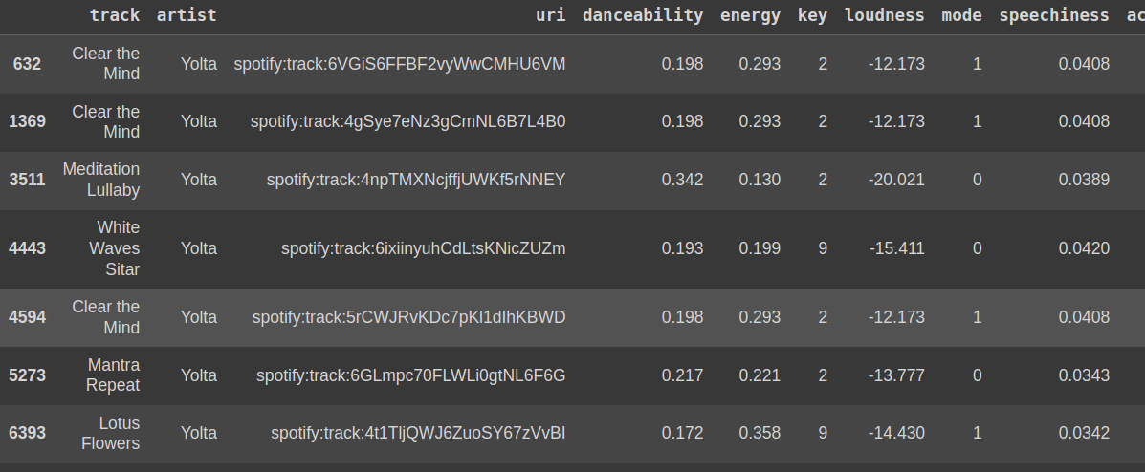
Overview
Business Question
Data Cleaning
Exploratory Analysis
Feature Engineering
Modeling phase
Product change
Check for empty values
Remove duplicates based artist + track (a song name)

Slide 4
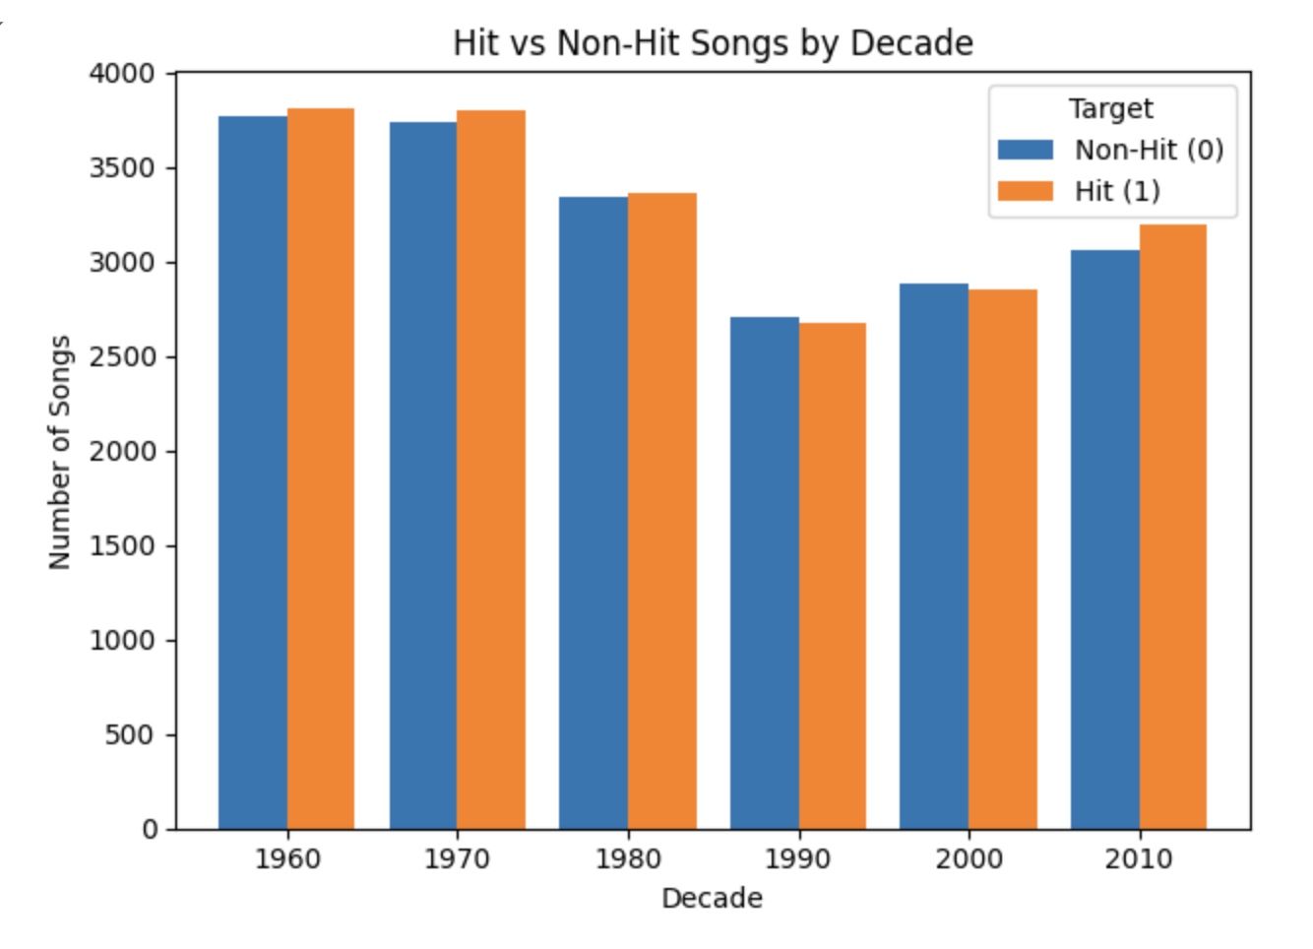
Business Question
Data Cleaning
Exploratory Analysis
Feature Engineering
Modeling phase
Product change
Combined all the datasets from 1960s to 2010s (total ~39K)
Some trends tend to come back from old days
Data ratio is approximately divided by 50/50 for hit & non-hit songs

Slide 5
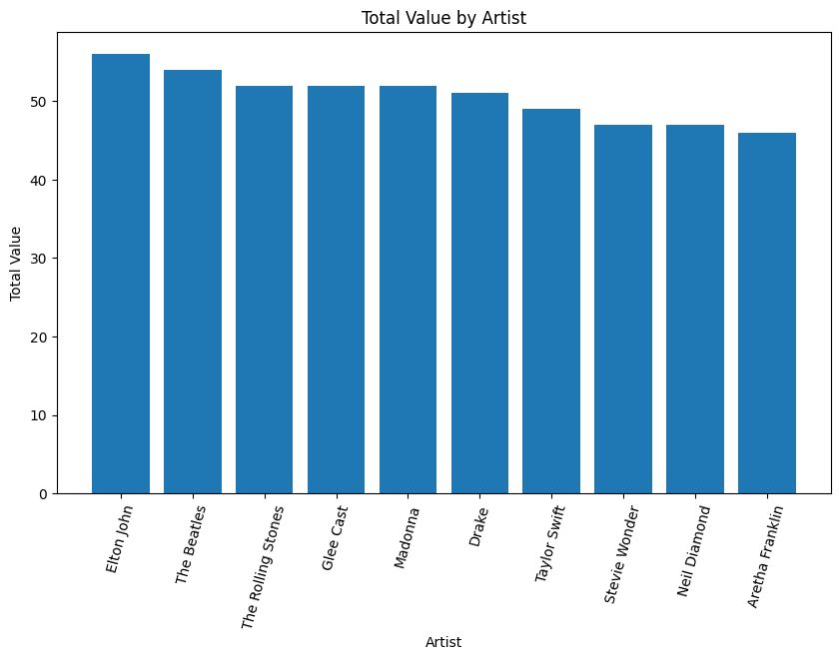
Business Question
Data Cleaning
Exploratory Analysis
Feature Engineering
Modeling phase
Product change
How significant is the artist’s influence on a song's success? For example, do established artists like Taylor Swift tend to produce hits more consistently than others?

Slide 6
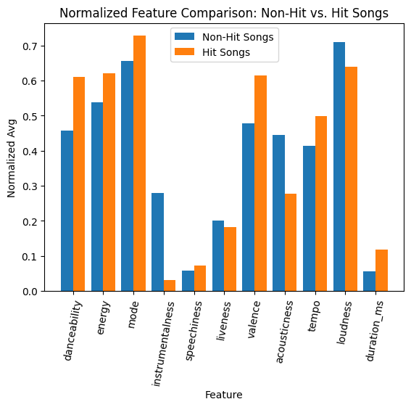

Slide 7
Overview
Business Question
Data Cleaning
Exploratory Analysis
Feature Engineering
Modeling phase
Product change
Add collaboration number column in the same song
2. Add decades columns and transform it to boolean as categorical data
3. We transform the title into a numeric value (length of the title)
Notes:
1.Extract the featuring artists by the following delimiters: Featuring, feat., X or x and symbols like +, -, ,, &, and /
3. Our assumption: shorter title might be more catchy and easier to remember

Slide 8
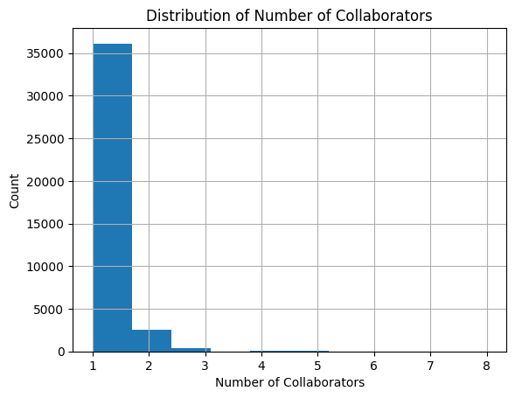
Overview

Slide 9
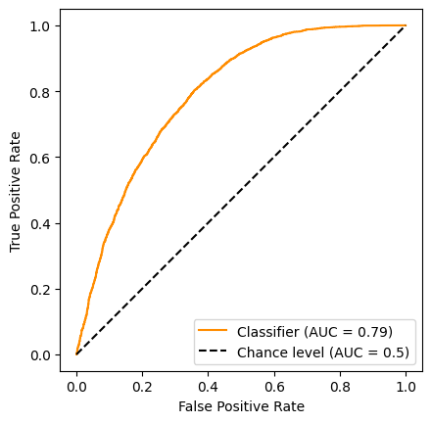
Overview
Business Question
Data Cleaning
Exploratory Analysis
Feature Engineering
Modeling phase
Product change
Logistic Regression
avg_danceability,
- avg_loudness,
- avg_speechiness,
- avg_instrumentalness,
- avg_duration_ms,

Slide 10
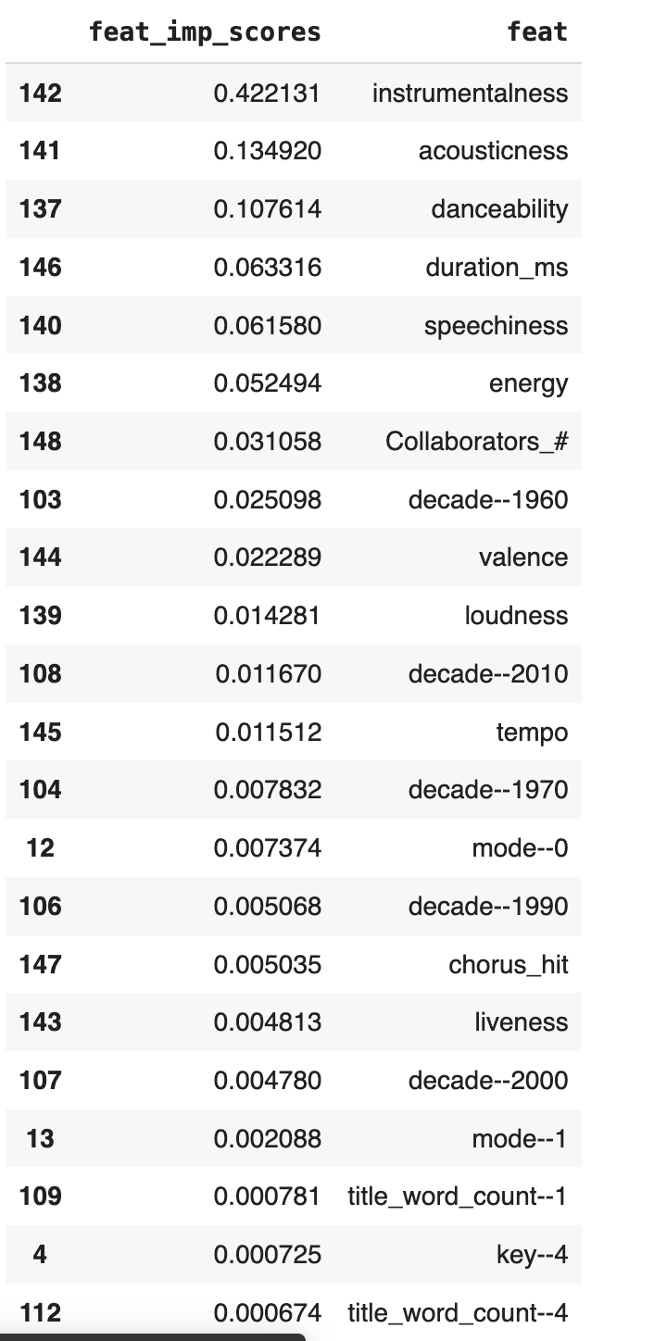
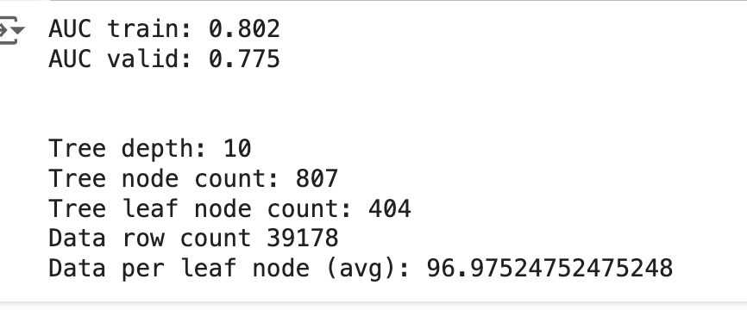
Overview
Decision Trees
 | Decision Trees | Random Forest | Boosted Trees (XGB Classifier)
AUC train | 0.802 | 0.940 | 0.960
AUC valid | 0.775 | 0.802 | 0.828

Slide 11
Overview
Business Question
Data Cleaning
Exploratory Analysis
Feature Engineering
Modeling phase
Product change
Suggestions for the music producer:
Avoid instrumentality in the songs as it has a negative correlation to
Danceable songs has higher chance of becoming a hit
Hit songs weren't as loud as flopped songs
Non-hit songs duration on avg is ~4 min
Hit songs duration on avg ~3 min

Slide 12

With our model, we can predict the song success with 80% of the accuracy given the features

Slide 13


Thank You!
By Gulzhan, Firuz, Kalys

